Slide 1

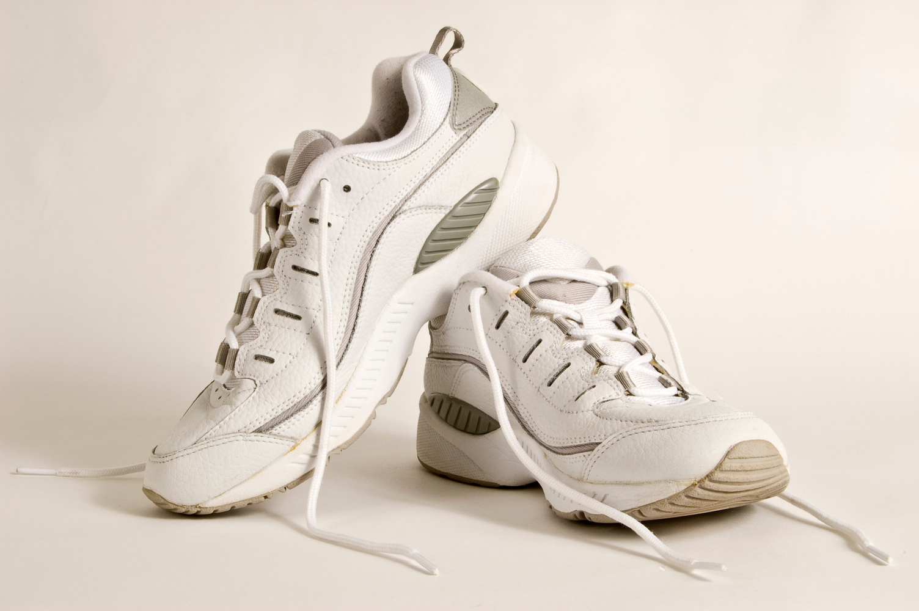

"These Borcelle runners are priced at $80 which I think is a great deal. Why? You can use it for light training and running as well while maintaining the same comfort regardless of the type of your training. I'm gonna grab another pair soon!"
Juliana Silva
@reallygreatsite

